Slide 1
McDonald’s: History, Origin, Journey & Milestones
From Drive-In to AI-Powered Fast Food

Slide 2
How It All Began (1940)
1940: Richard and Maurice McDonald open a drive-in restaurant in San Bernardino, California.
Customers park their cars, and servers bring food to them.
At first, the menu had many items.

Slide 3
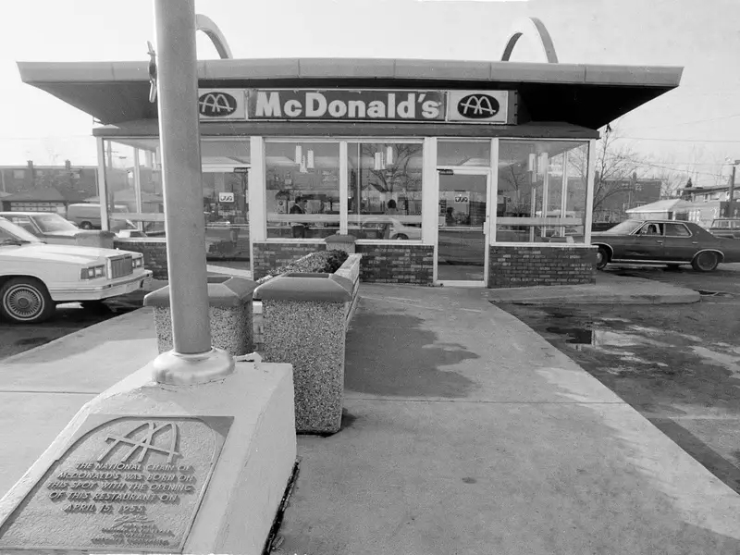

Slide 4
Speedee Service System (1948)
Brothers simplify menu to burgers, fries, and drinks.
Kitchen arranged like a factory assembly line — each worker has one job.
Food is ready in less than a minute.

Slide 5
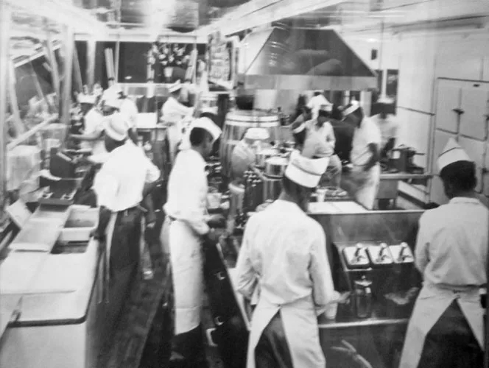

Slide 6
Ray Kroc & Expansion (1955)
Milkshake machine salesman Ray Kroc visits and is impressed.
Opens first franchise in Illinois.
Forms McDonald’s Corporation to expand nationwide.

Slide 7
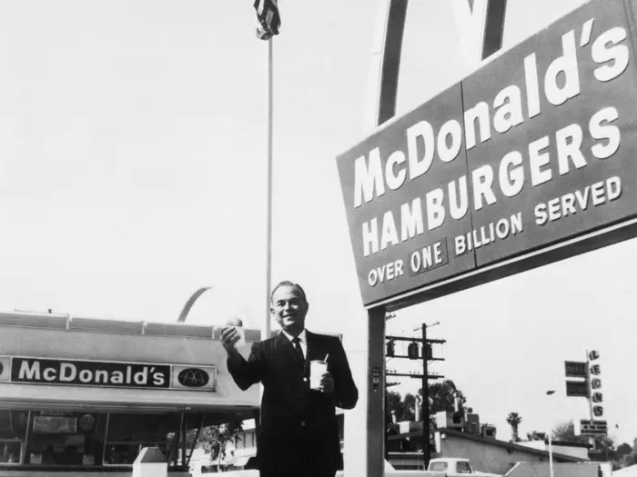

Slide 8
Growing Bigger (1960s–1970s)
Introduced Ronald McDonald clown mascot for kids.
Added famous Big Mac burger.
Started drive-thru service — customers order & collect food without leaving the car.

Slide 9
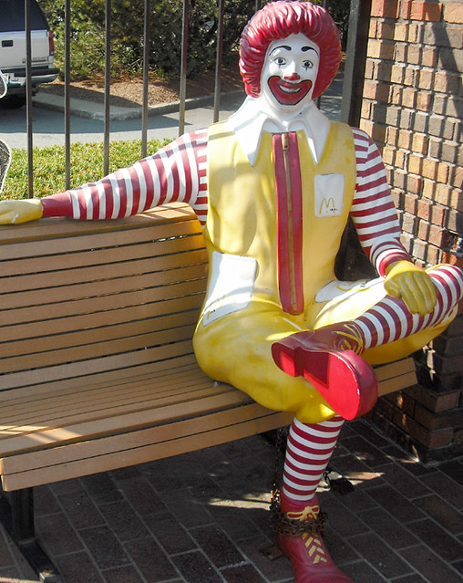

Slide 10
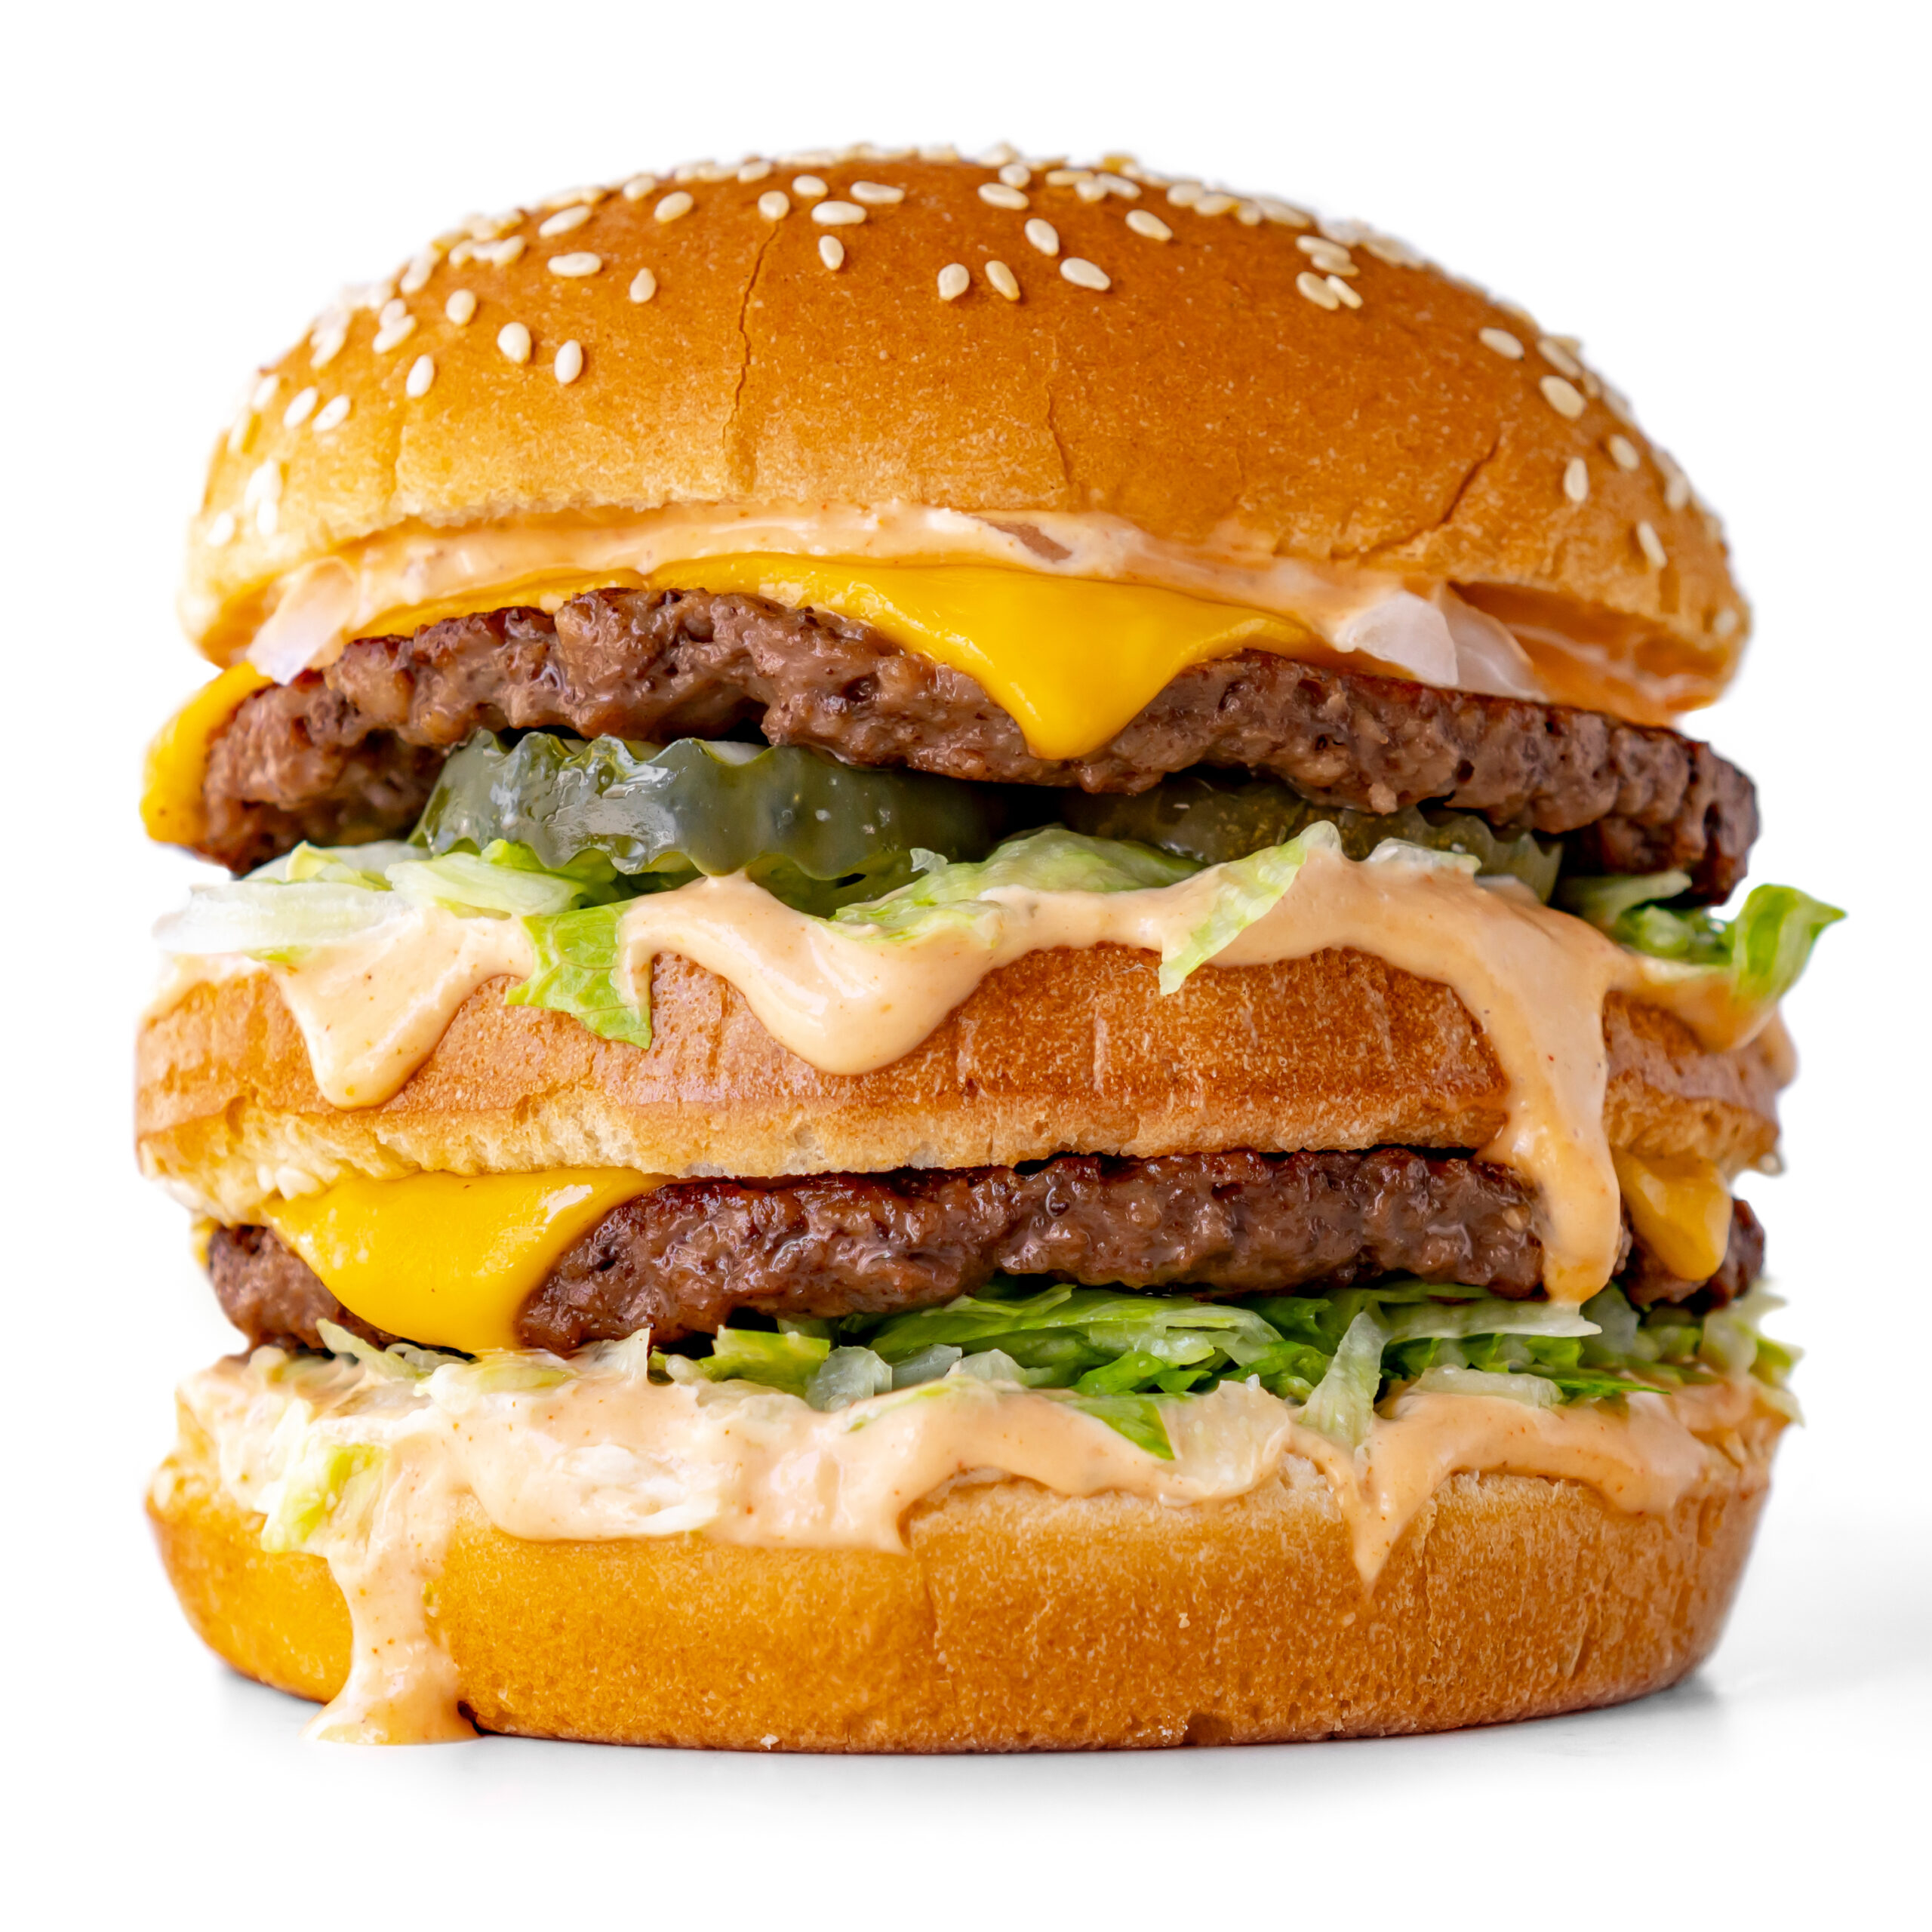

Slide 11
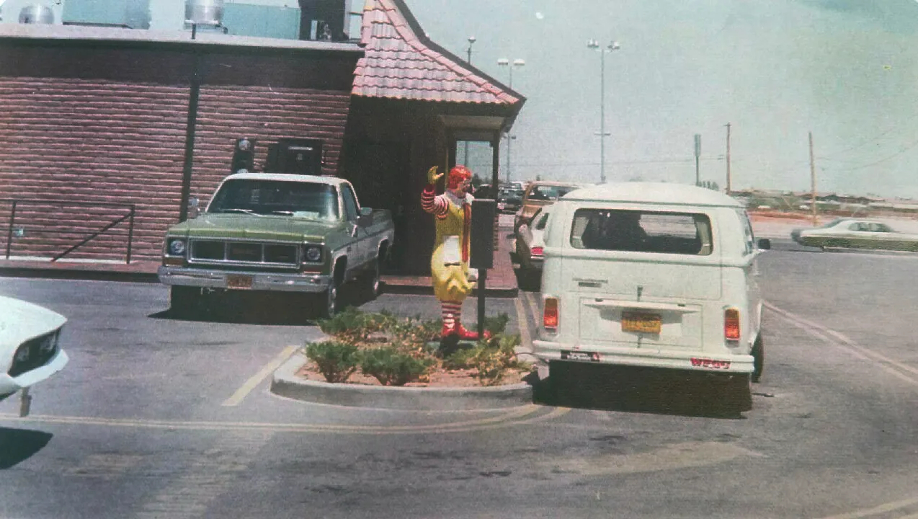

Slide 12
Global Expansion (1980s–1990s)
Spread to many countries.
Entered India in 1996.
Created local menu items like McAloo Tikki for Indian tastes.

Slide 13
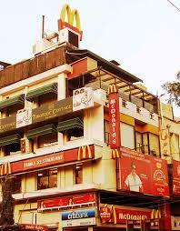

Slide 14
The AI & Technology Era (2010–Present)
Self-order kiosks for faster ordering.
Digital menu boards that change with time, weather, or popular choices.
Mobile ordering apps.
Kitchen automation for speed and accuracy.

Slide 15
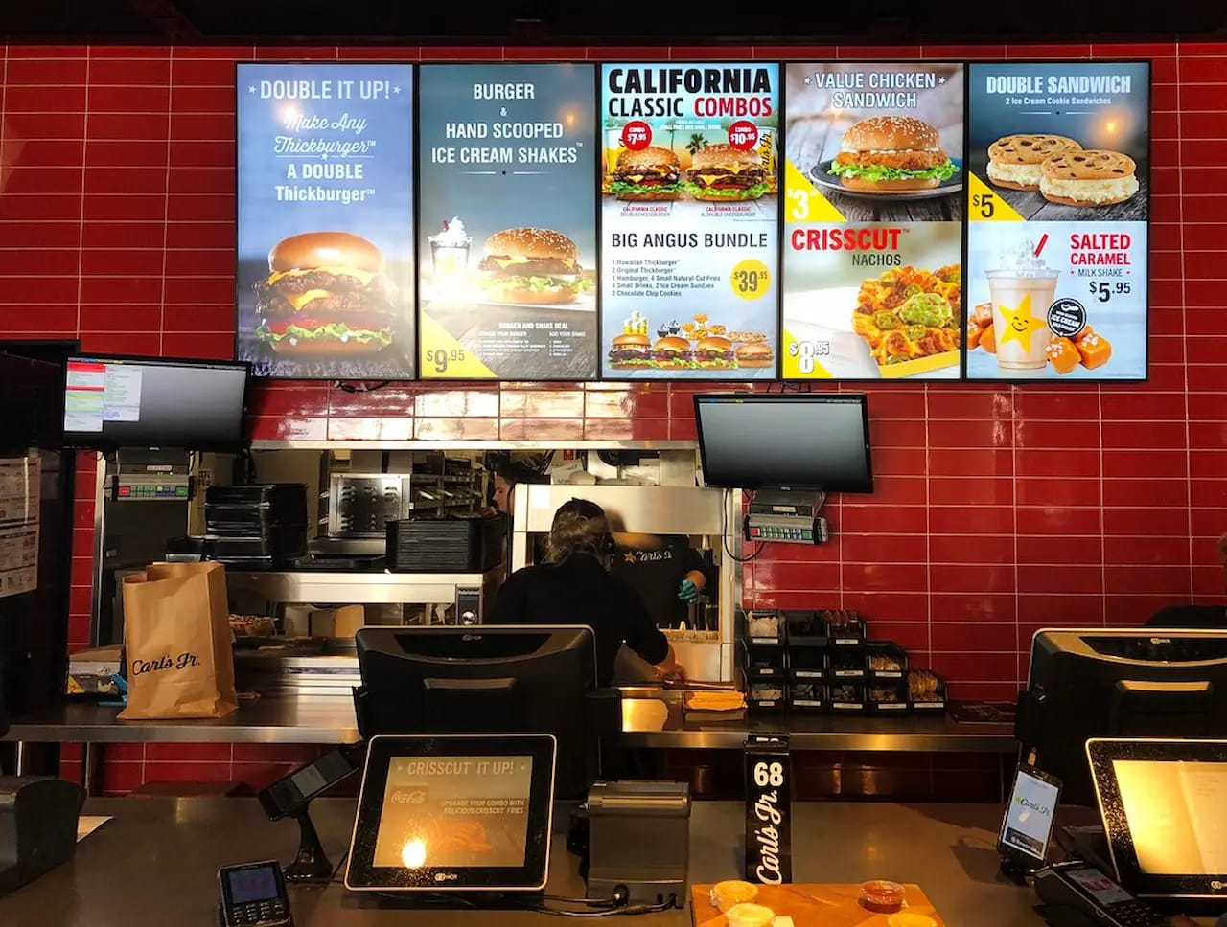

Slide 16
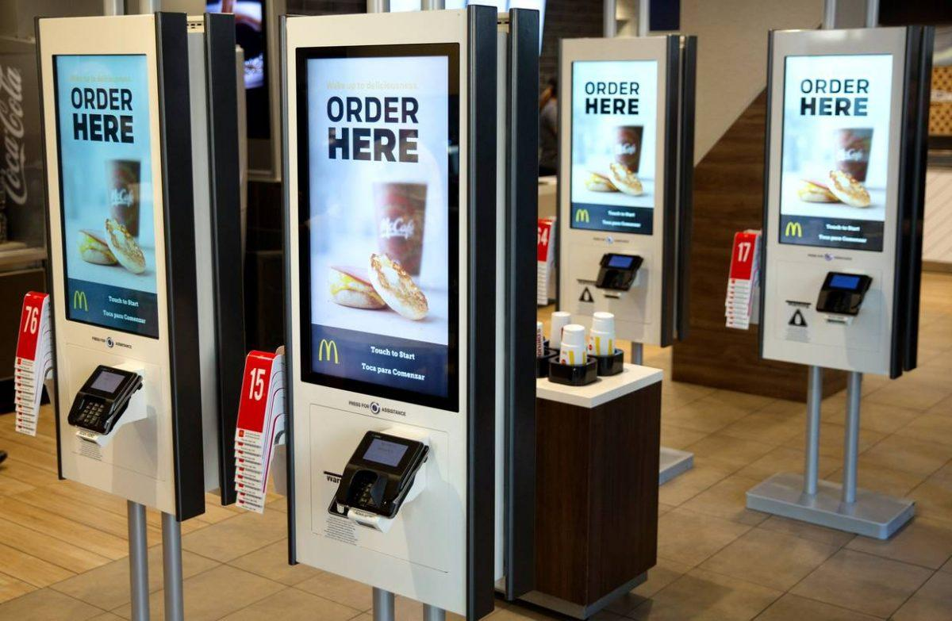

Slide 17
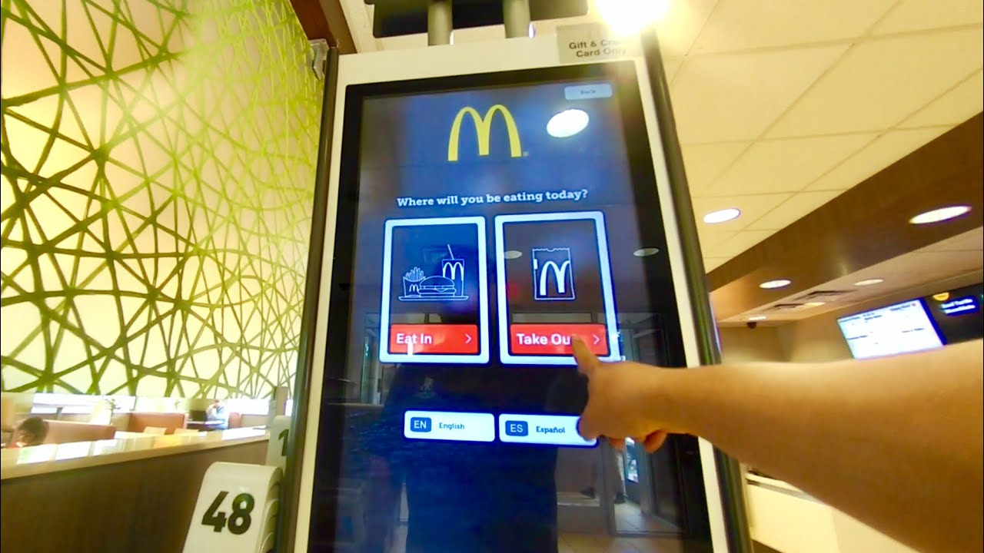

Slide 18
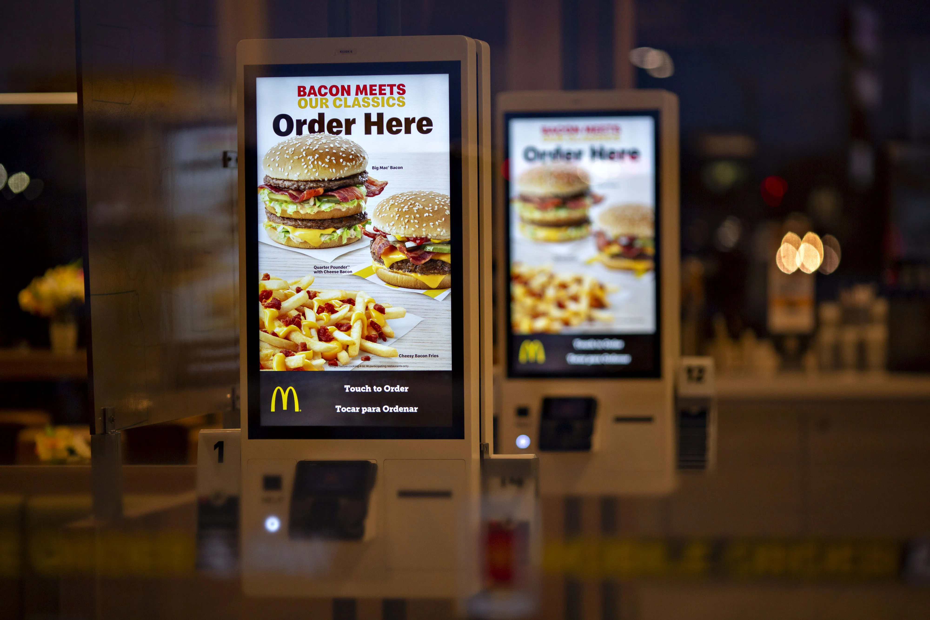

Slide 19
Key Milestones Recap
1940 – First drive-in store opens.
1948 – Speedee Service System.
1955 – First franchise & McDonald’s Corporation.
1967 – First international store (Canada).
1996 – McDonald’s India launch.
2010 onwards – AI & automation in stores.

Slide 20
